Slide 1

Pair-a-dice: Exploring Machine Learning for
Pairs Trading
Caleb Lin
Kinjalk Srivastava
Notes:
It’s an intended pun, but it’s later that we discover its real meaning. I mean, it’s like rolling a dice, some of the result we found out was really unexpected.

Slide 2




Problem statement
Pair-a-dice by Caleb & Kinjalk
Machine Learning
Pair trading
Idea is simple.
But HOW?
Notes:
Problem Statement:
We know pair trading, we know machine learning.
Want to combine then to improve performance.
Simple idea, but how?

Slide 3
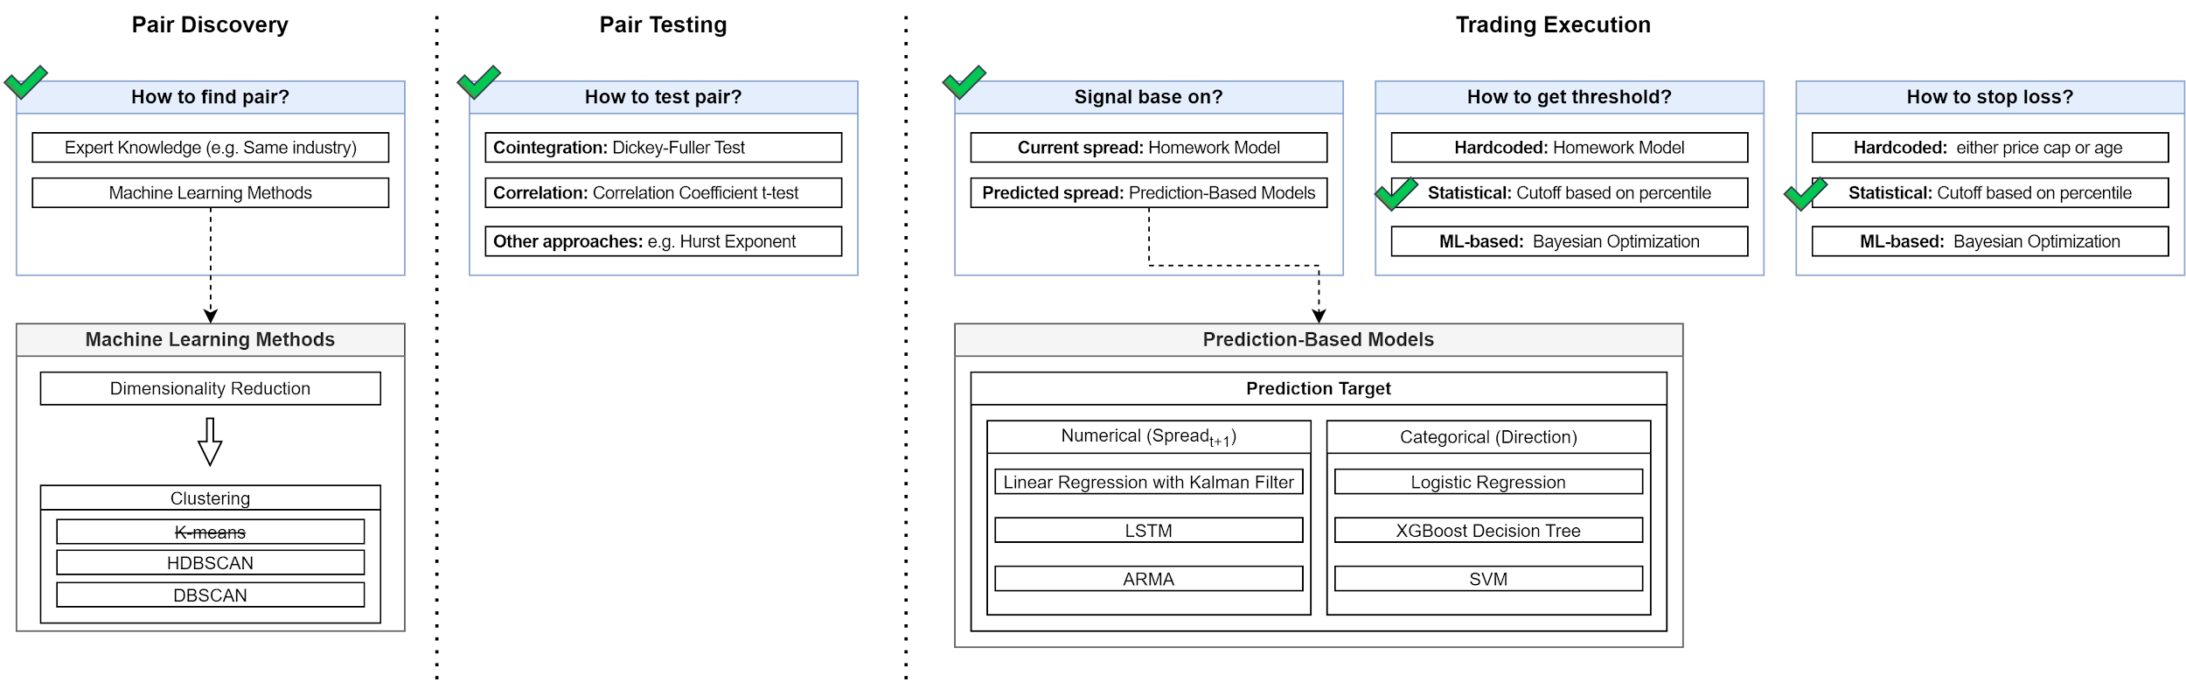

Conceptual framework: foundation for project
Pair-a-dice by Caleb & Kinjalk
Not Yet
Not Yet
Thinking top-down, on which step of pair trading can we improve with machine learning?
Theoretically ALL! But we choose a few to explore.
Notes:
Problem Statement:
We know pair trading, we know machine learning.
Want to combine then to improve performance.
Simple idea, but how?

Slide 4
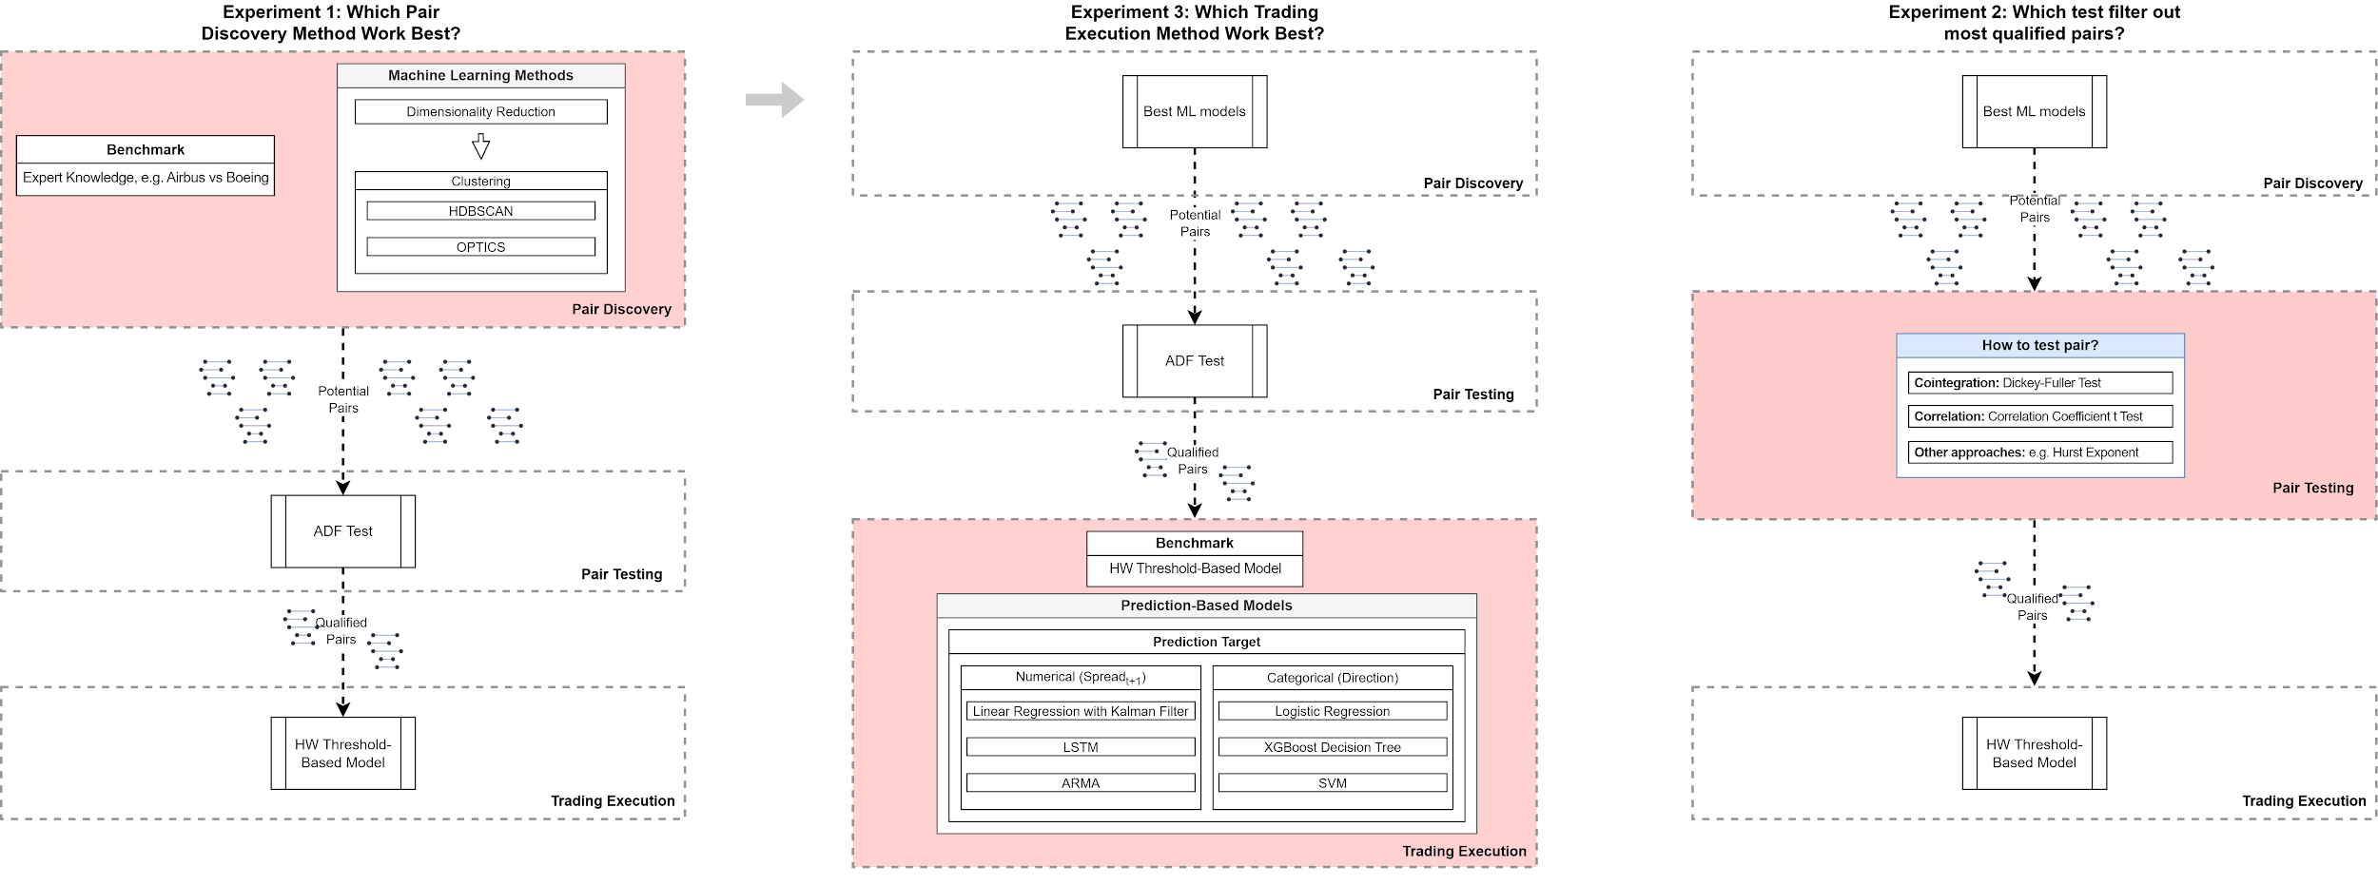
Overall Experiment Design
Pair-a-dice by Caleb & Kinjalk
Closer look later!
Notes:
Add a timeline chart to make it clear the train and test set for each experiment (shown in each section not here)

Slide 5
Data Source & Tools
Pair-a-dice by Caleb & Kinjalk
Data
WRDS (CRSP & Compustat)
Daily prices, Monthly fundamental ratios
Jan 1, 2016 - Dec 31, 2020
Train & Validation/Test will be specified for each experiment
Environment
Google Colab
Intel Xeon CPU @ 2.20GHz (2 cores), 13 GB RAM
Tools
Mostly Python
Data: pandas, NumPy, statsmodels
ML: sklearn
DL: TensorFlow, Keras, PyTorch
Optimization: BoTorch
Visualization: Matplotlib, Seaborn

Slide 6
Pair discovery method explained
Pair-a-dice by Caleb & Kinjalk
Define Expert knowledge
Airbus vs Boeing; find pair in the same sector
Why not expert knowledge?
Why not just find pair in the same sector?
Not so obvious: fewer people trade, more room for arbitrage
Why not just exhaust every possible pair?
Resource constraint & Multiple comparisons problem
Why dimensionality reduction?
Thousands of records, not practical to use all
Notes:
Storyline:
First the naive ideas, then why not
Why not expert knowledge?
Why not using sector info? (count as expert knowledge)
Not so obvious - leave room for arbitrage
Why not just exhaust every possible pair?
Resource constraint
False positive problem = multiple comparisons problem
Why dimensionality reduction
ML model (1-2 slides)
Just introduce the different approaches will be fine
I.e. the density based approach and distance based approach (and why don’t we use it)

Slide 7
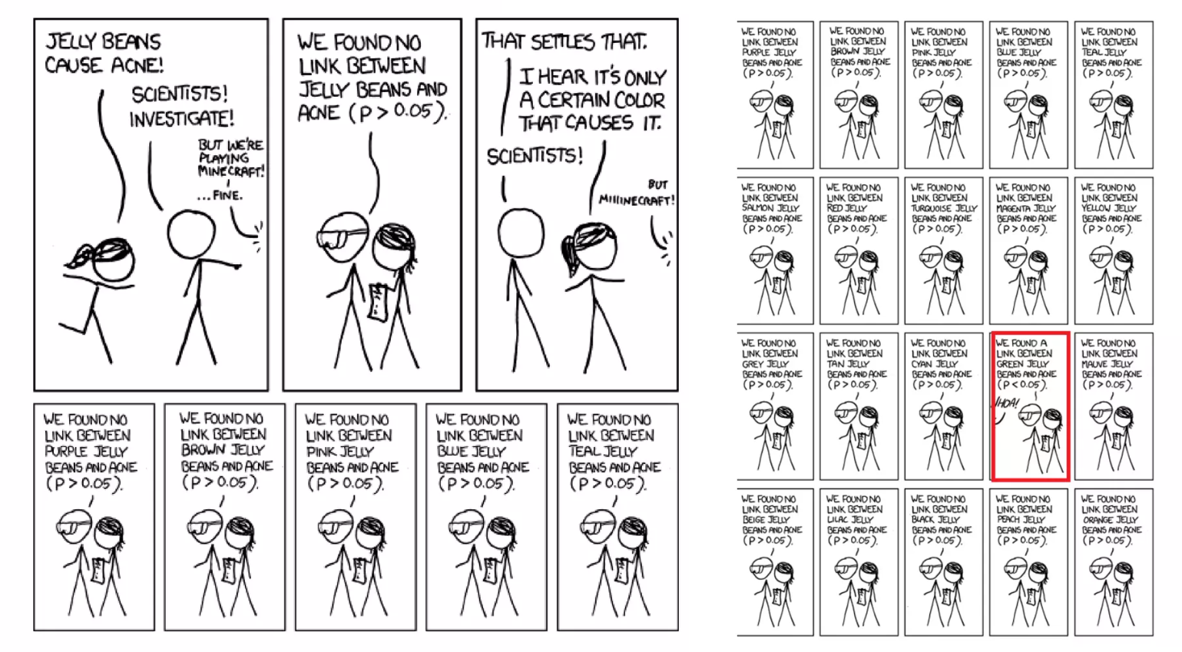
Multiple comparisons problem
Pair-a-dice by Caleb & Kinjalk
Simple math!
(FP = False Positive)
Assume
FP Rate: 5%
1000 pairs
Remind
FP Rate =FP/FP+TN
Math
FP Pair
= ~1000*5%
= 50 !
* Illustration drawn by Hiroki Oura

Slide 8
ML models in Pair discovery explained
Pair-a-dice by Caleb & Kinjalk
Step 1: Dimensionality Reduction using PCA (Principal Component Analysis)
Purpose:
Reduce Complexity: Financial datasets often contain numerous variables, which can lead to high dimensionality. PCA helps in reducing the dimensionality of the dataset while retaining the variance (information) that is most important.
Noise Reduction: By focusing on principal components with the highest variance, PCA can help filter out noise and less significant variables.
Improved Visualization and Insight: Reduced dimensions can be visualized more easily and can offer clearer insights into the structure of the data.
How It Works:
Mathematical Formulation:
Y=XW
Notes:
Storyline:
First the naive ideas, then why not
Why not expert knowledge?
Why not using sector info? (count as expert knowledge)
Not so obvious - leave room for arbitrage
Why not just exhaust every possible pair?
Resource constraint
False positive problem = multiple comparisons problem
Why dimensionality reduction

Slide 9
Pair-a-dice by Caleb & Kinjalk
Where:
X is the data matrix,
W is the matrix of eigenvectors (principal components),
Y is the matrix of transformed features (principal components scores).
Rationale:
PCA transforms the data into a new coordinate system where the greatest variances by some scalar projection of the data come to lie on the first few principal axes. This is particularly useful in financial data where many features might be correlated.
Step 2: Clustering with DBSCAN and HDBSCAN
Purpose:
Discover Natural Groupings: Clustering helps in identifying natural groupings among data points. In your case, it helps find groups of companies with similar stock price movements or financial characteristics.
Foundation for Pairs Trading: By clustering companies based on features derived from their historical prices or derived financial metrics, you can identify groups of companies that are likely to move in similar patterns.

Slide 10
Pair-a-dice by Caleb & Kinjalk
Why DBSCAN (Density-Based Spatial Clustering of Applications with Noise)?
Handles Noise: DBSCAN is effective in identifying outliers and noise, making it robust for financial datasets that often contain anomalies.
Does Not Require Specifying Number of Clusters: Unlike K-means, DBSCAN does not require the number of clusters to be defined a priori, which is advantageous when the inherent structure of the data is unknown.
Why HDBSCAN (Hierarchical DBSCAN)?
Flexible Density Clustering: HDBSCAN extends DBSCAN by converting it into a hierarchical clustering algorithm and extracting flat clusters based on the stability of clusters. This is useful for financial data where cluster stability might vary significantly across the data spectrum.
Handling Varying Density Clusters: HDBSCAN is capable of identifying clusters of varying densities, which is common in datasets comprising companies of different sizes and financial health.

Slide 11
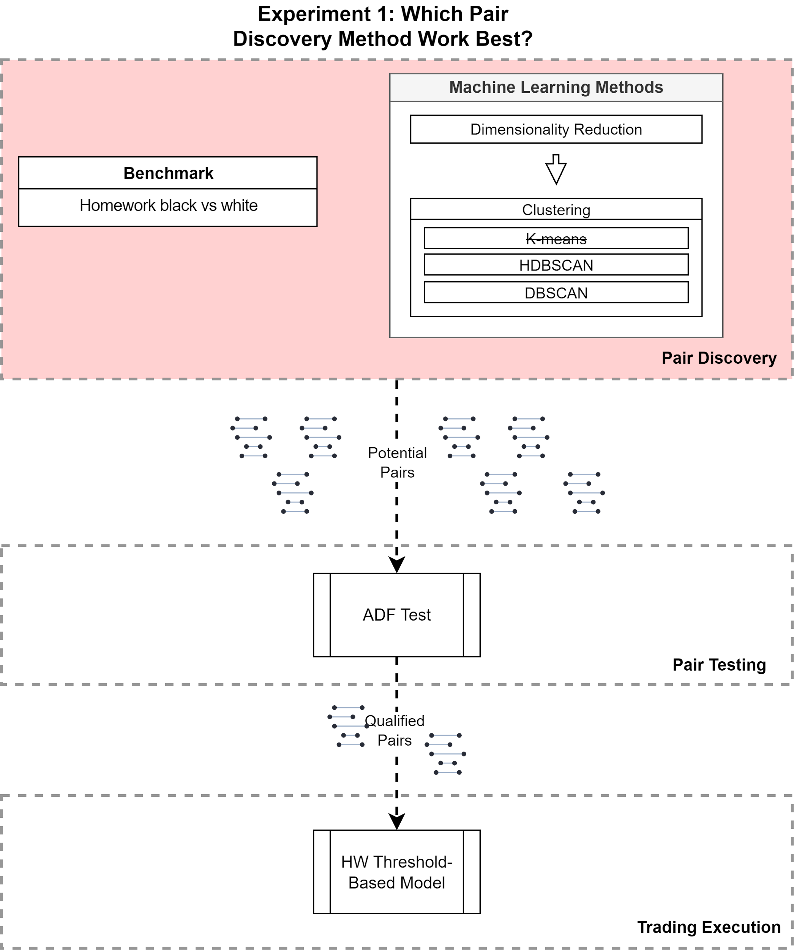
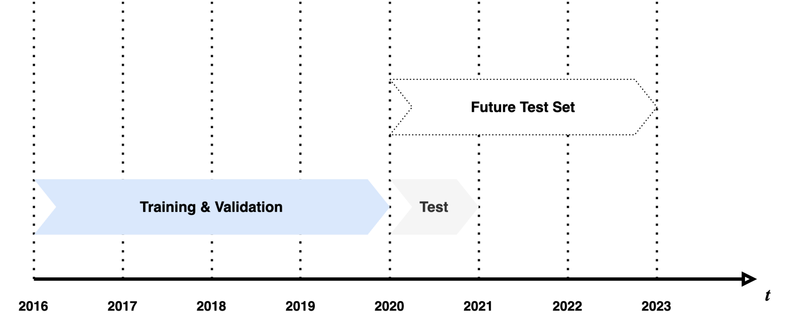
Experiment design 1: Pair discovery
Pair-a-dice by Caleb & Kinjalk

Slide 12
Result 1: Pair discovery
Pair-a-dice by Caleb & Kinjalk
Finding 1: Significantly reduce the number of pairs to run the Dickey-Fuller Test!
- Initial dataset comprised 498 stocks, resulting in approximately 61,876 potential pairs for evaluation.
- Clustering techniques (HDBSCAN and DBSCAN) were employed to reduce the number of pairs:
- HDBSCAN identified 342 (0.5%) pairs for further investigation.
- DBSCAN yielded 1,066 (1%) pairs for evaluation.
- Further refinement was achieved through cointegration tests:
- Out of the initial 342 pairs identified by HDBSCAN, only 11 exhibited cointegration.
- Similarly, out of the initial 1,066 pairs identified by DBSCAN, only 20 displayed cointegration.
Notes:
Finding 1: general performance
1.1 Stationarity (the density plot)
1.2 Trading performance (Compared to hw?)
Finding 2: why some models are better than others? e.g. DBSCAN why better than K-means?
Finding 3: Out-of-industry pairs
Percentage
Pick out one as example to illustrate

Slide 13
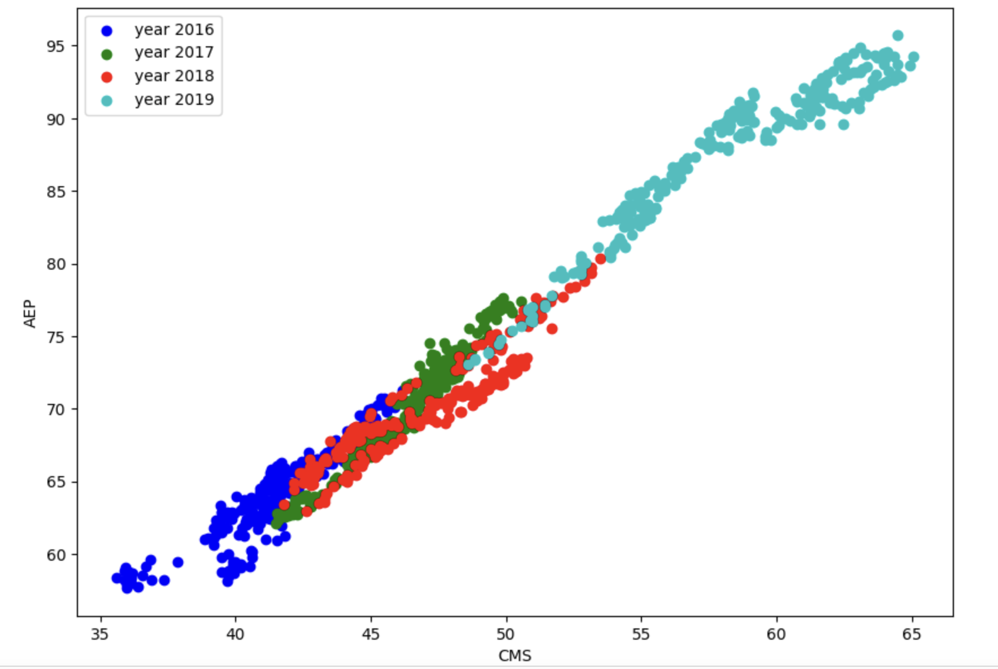
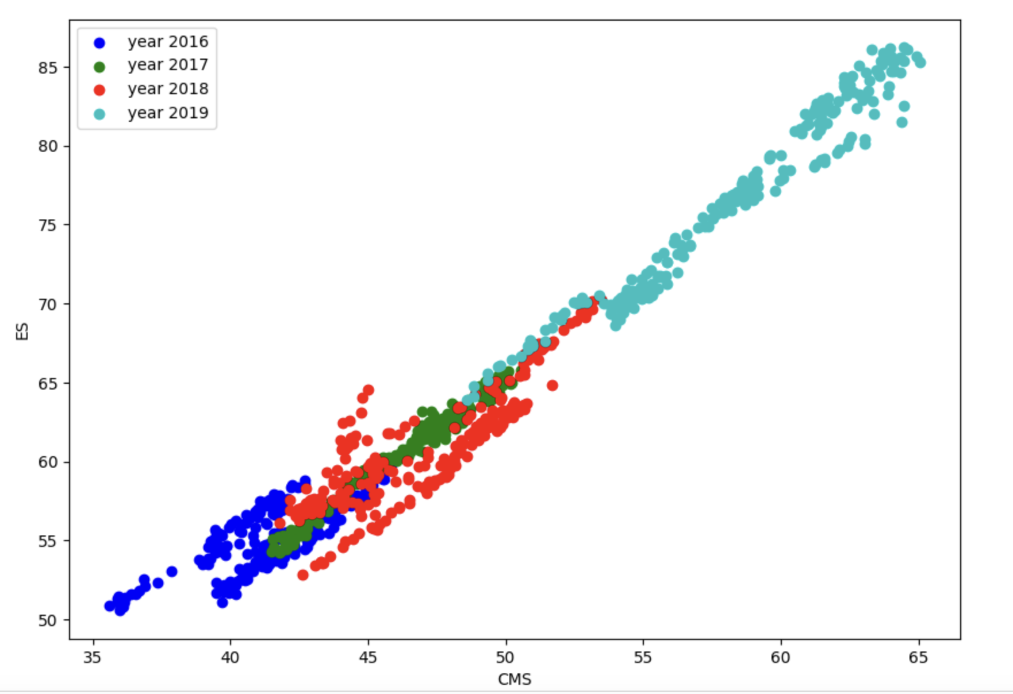
Pair-a-dice by Caleb & Kinjalk
Example Graph of HDBSCAN Cointegration:
Finding 1: general performance
Finding 1.1: # of pairs to evaluate
1.1 Stationarity (the density plot)
Example Graph of DBSCAN Cointegration:
Finding 2: We do find stationary pairs through the approach!
Notes:
Finding 1: general performance
1.1 Stationarity (the density plot)
1.2 Trading performance (Compared to hw?)
Finding 2: why some models are better than others? e.g. DBSCAN why better than K-means?
Finding 3: Out-of-industry pairs
Percentage
Pick out one as example to illustrate

Slide 14
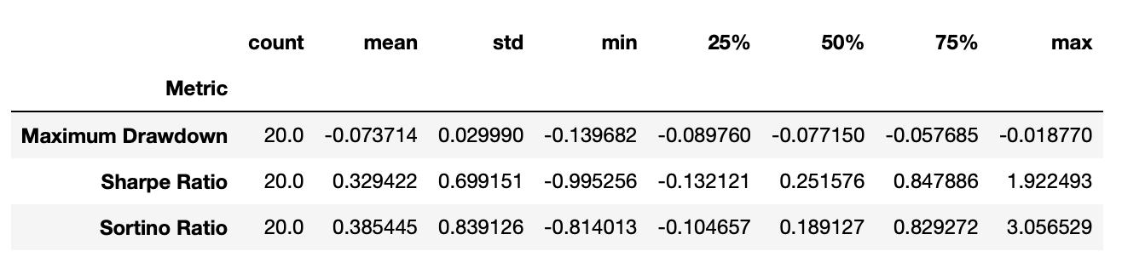
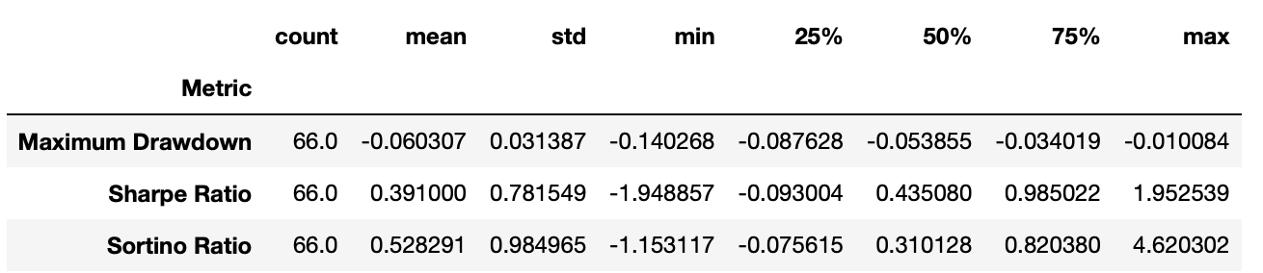
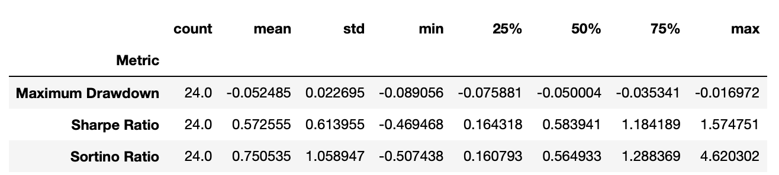
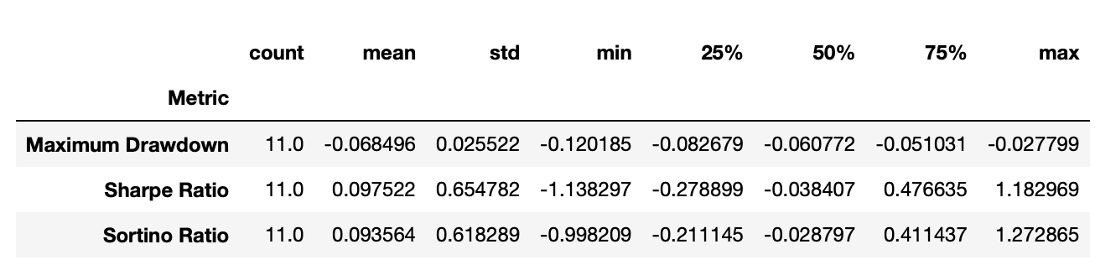
Result 1: pair discovery
Pair-a-dice by Caleb & Kinjalk
DBSCAN CORRELATION
DBSCAN COINTEGRATION
HDBSCAN CORRELATION
HDBSCAN COINTEGRATION
Finding 3: Performance equal/better than homework pairs!

Slide 15
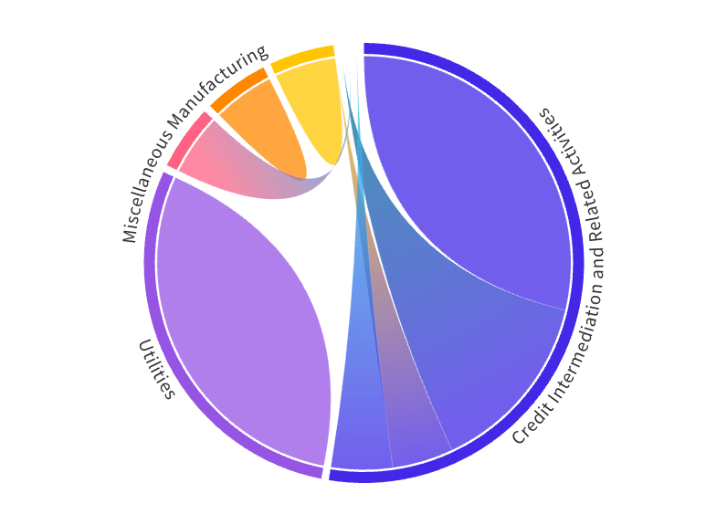
Result 1: Pair discovery
Pair-a-dice by Caleb & Kinjalk
Finding 4: Considerate amount of out-of-industry pairs!
 | Cointegration
DBSCAN | 45%
HDBSCAN | 36%
Subtotal | 41%
Notes:
Finding 1: general performance
1.1 Stationarity (the density plot)
1.2 Trading performance (Compared to hw?)
Finding 2: why some models are better than others? e.g. DBSCAN why better than K-means?
Finding 3: Out-of-industry pairs
Percentage
Pick out one as example to illustrate

Slide 16
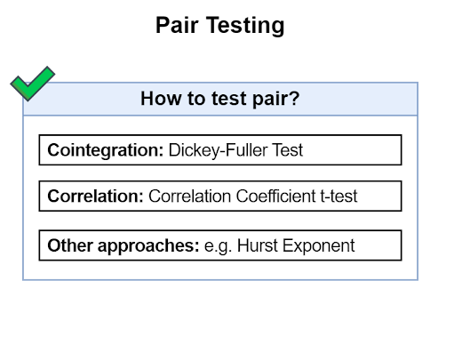
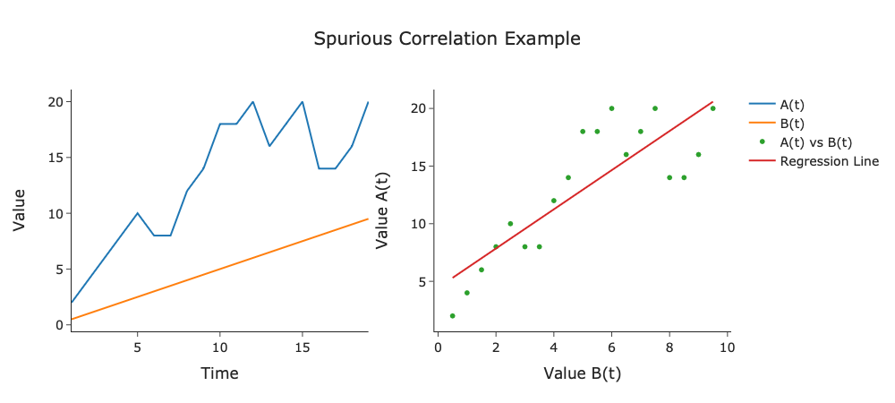

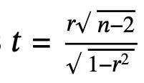

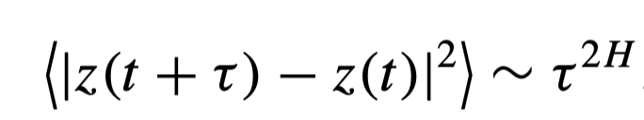
Pair testing explained
Pair-a-dice by Caleb & Kinjalk
Approach | Formula | Description
Cointegration: Dickey-Fuller Test |  | Stationarity, long-run equilibrium, mean-reversion, assumed better performance
Correlation: Correlation Coefficient Test |  | Co-movement, linear relationship
Other: Hurst Exponent |  | Long-term memory, mean reversion strength

Slide 17
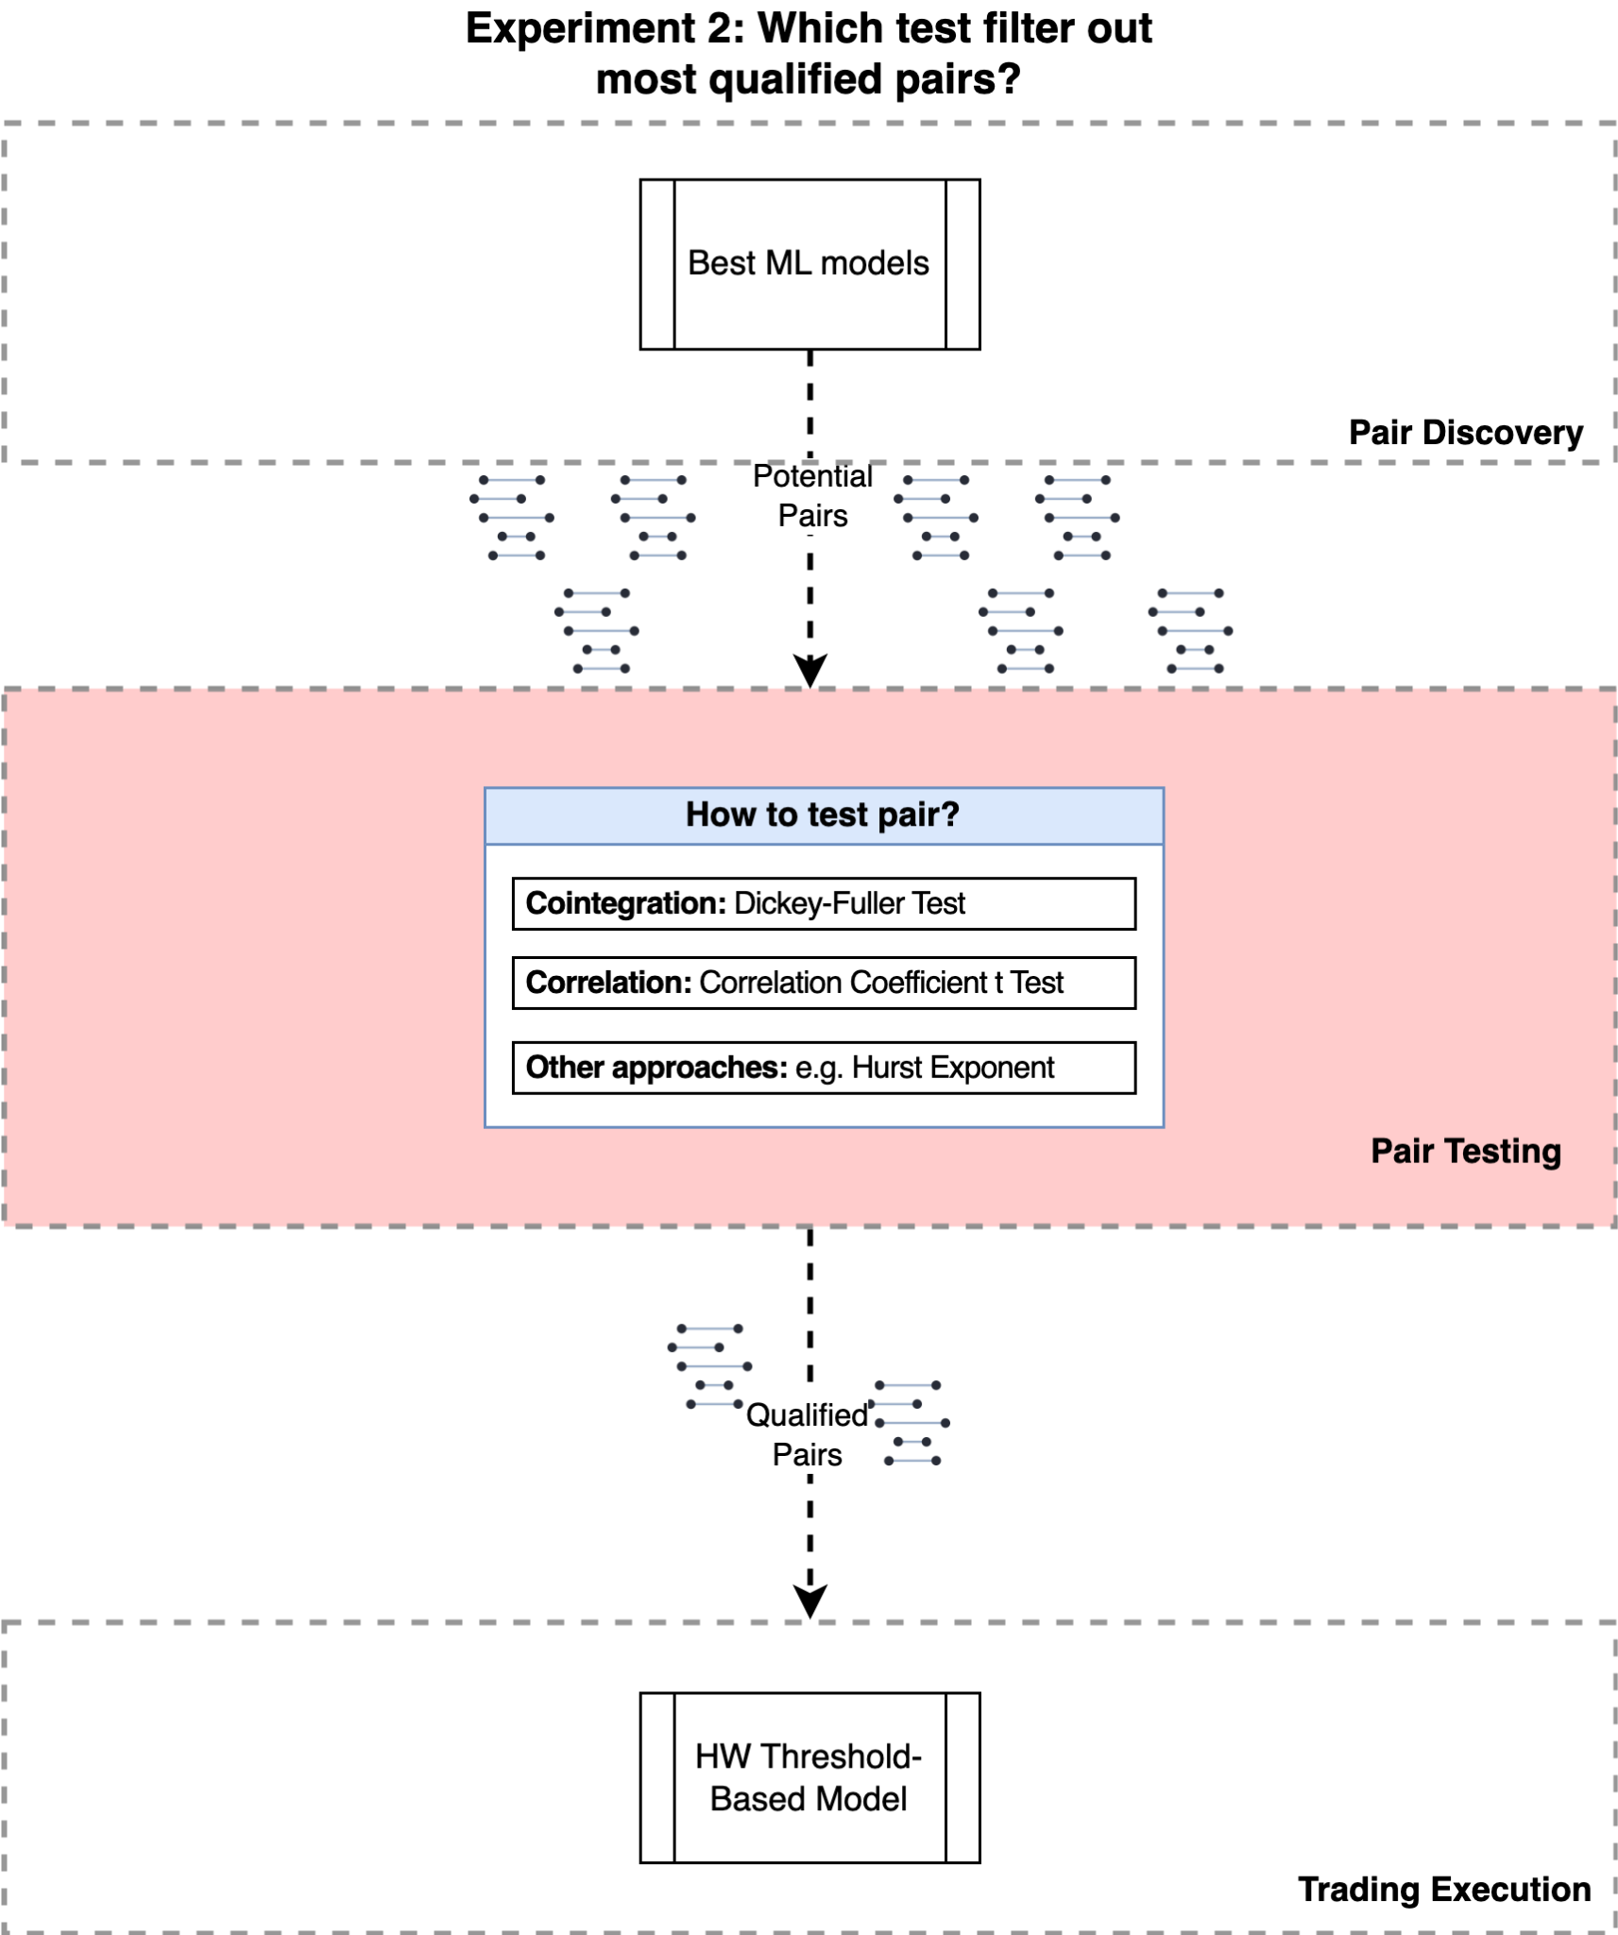
Experiment design 2: Pair testing
Pair-a-dice by Caleb & Kinjalk

Slide 18
Result 2: pair testing
Pair-a-dice by Caleb & Kinjalk
Finding 1: INFERENCE: CLUSTERING INTERFERES WITH THE TESTS
DBSCAN CORRELATION
DBSCAN COINTEGRATION
HDBSCAN CORRELATION
HDBSCAN COINTEGRATION
SHARPE RATIO RANKINGS: HDBSCAN CORRELATION > DBSCAN CORRELATION > DBSCAN COINTEGRATION > HDBSCAN COINTEGRATION

Slide 19
Result 2: pair testing
Pair-a-dice by Caleb & Kinjalk
Finding 2: Cointegration is better at finding out-of-sector pairs!
 | Cointegration | Correlation
DBSCAN | 45% | 21%
HDBSCAN | 36% | 21%
Subtotal | 41% | 21%
>

Slide 20
Trading execution method explained
Pair-a-dice by Caleb & Kinjalk
 | Actual (spread) | OldSignal | Predicted | NewSignal
t-(lookback_period-1)
…
t-2
t-1 | 0 | 0
Today | 0.5 | 0 | 2 ! | -1
 | 2 | 1 | 0.5 | 0
 | 0

Slide 21
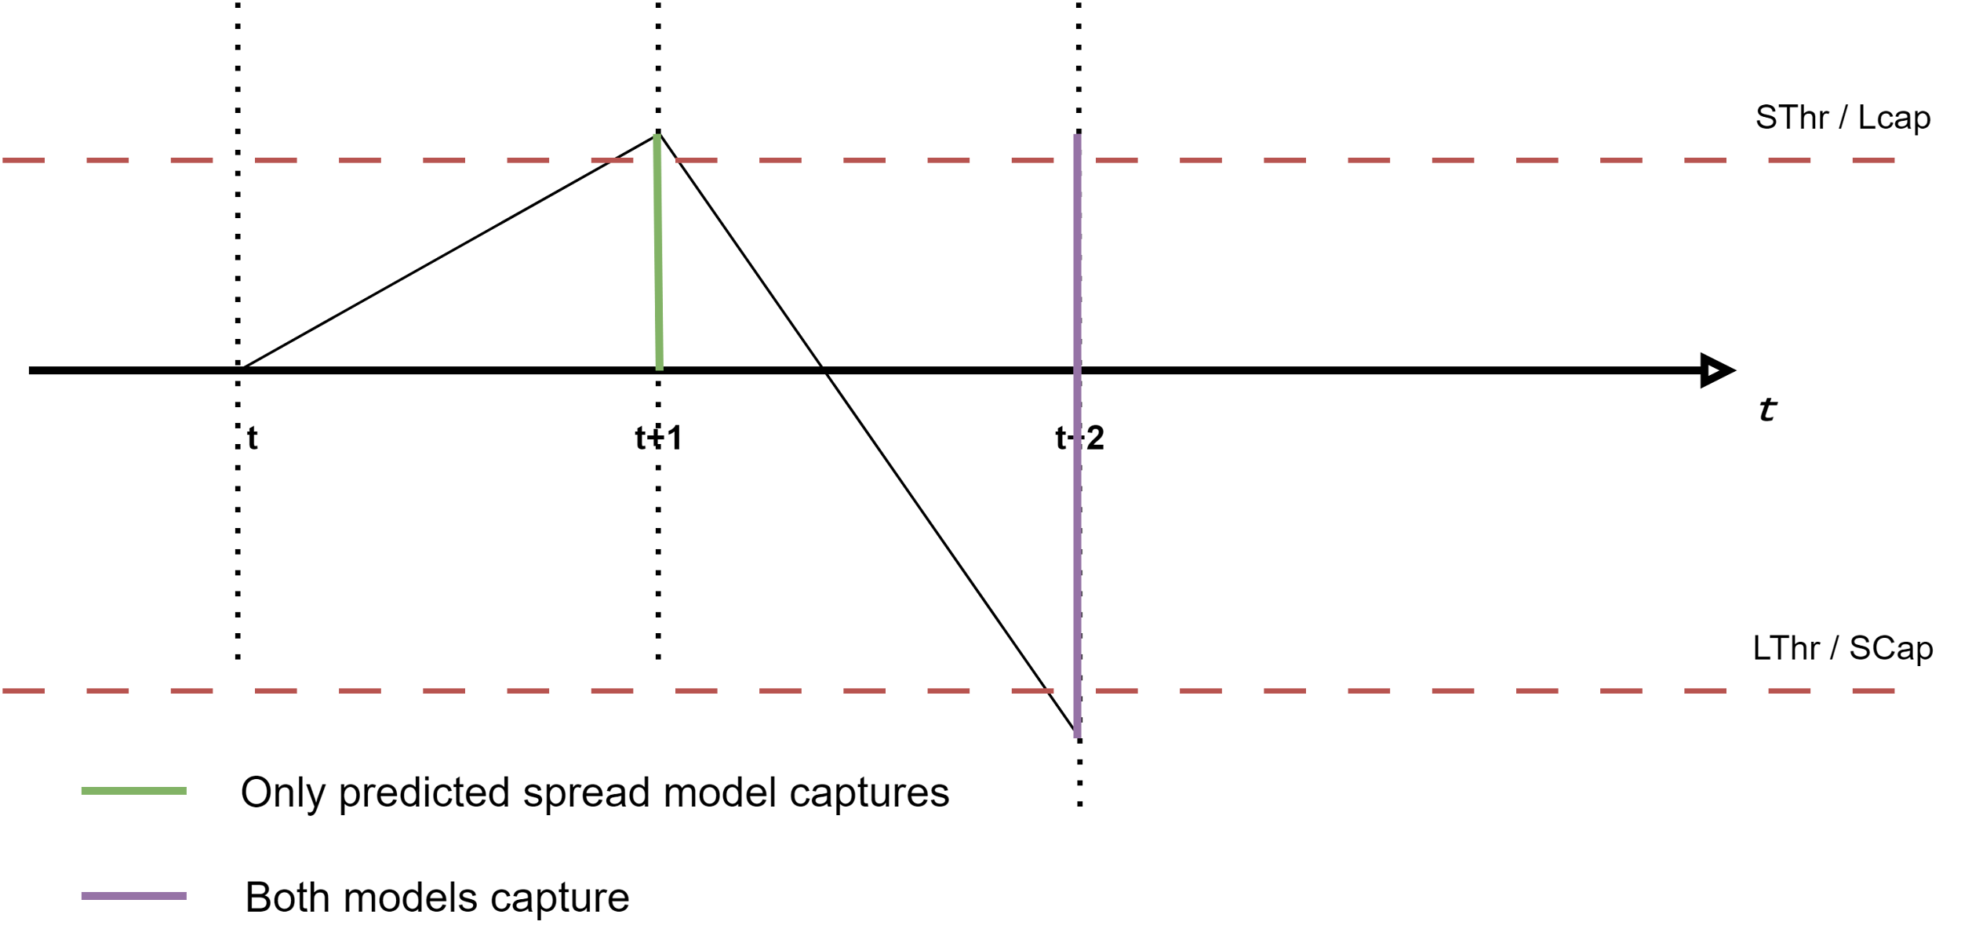
Trading execution method explained (Ctn’d)
Pair-a-dice by Caleb & Kinjalk
Modified Homework Model
Only changes:
Replace zdiff{n} with Predicted zdiff{n} to generate signals
 | zdiff{n} (spread) | OldSignal | Predicted zdiff{n} | NewSignal
t-(lookback_period-1)
…
t-2
t-1 | 0 | 0
Today | 0.5 | 0 | 2 ! | -1
 | 2 | 1 | 0.5 | 0
 | 0
* Illustration assumes that model perfectly predicts spread

Slide 22
Trading execution method explained (Ctn’d)
Prediction Model using an LSTM?
LSTM (Long Short Term Memory) is like a super-smart memory unit in a neural network, especially designed to understand and remember sequences of data over time. It's part of a family of models called Recurrent Neural Networks (RNNs), which are particularly good at tasks involving sequences, like time series data.
WHY LSTM?
Now, let's talk about why LSTM is useful for time series prediction:
Long-Term Dependencies: Traditional models like ARIMA struggle with capturing long-term dependencies in time series data. LSTM, with its specialized memory cells, can handle long-term dependencies more effectively.
Non-Linear Relationships: Time series data often contains complex, non-linear relationships between variables. LSTM's ability to learn complex patterns makes it well-suited for capturing these relationships.
Pair-a-dice by Caleb & Kinjalk

Slide 23
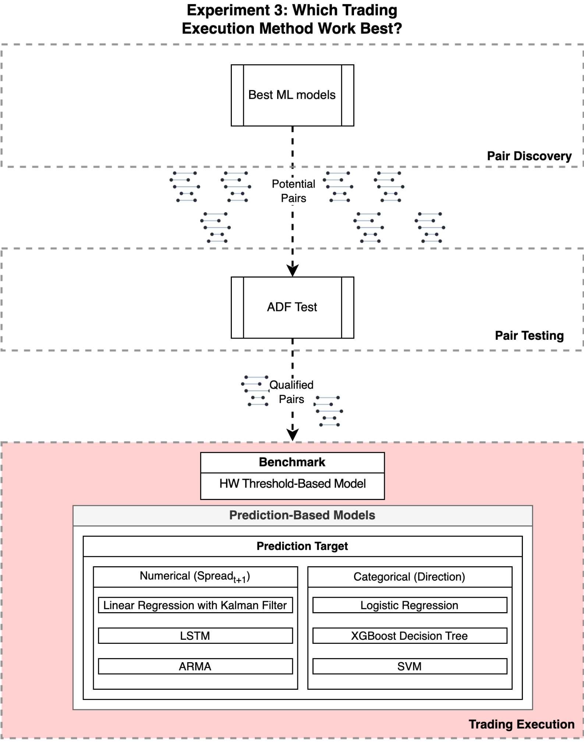
Experiment design 3: Signal generation
Pair-a-dice by Caleb & Kinjalk
Here, we just tested LSTM

Slide 24
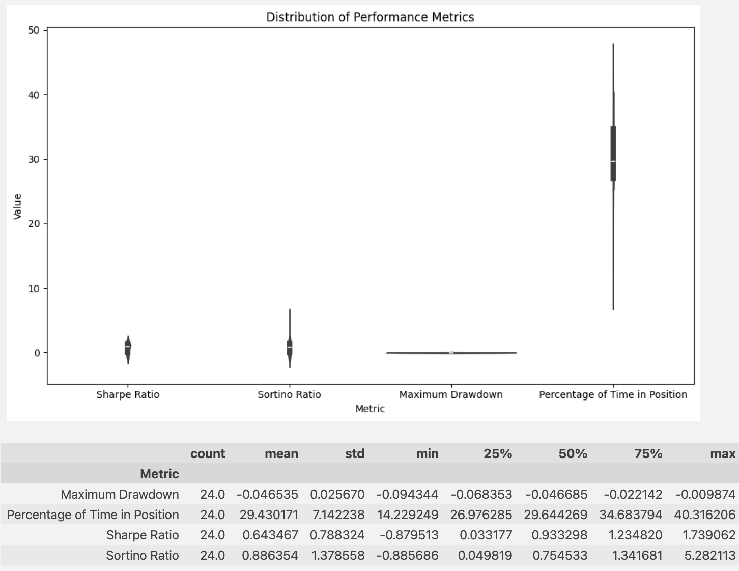
Result 3: trading execution
Pair-a-dice by Caleb & Kinjalk
Test result based on best model:
HDBSCAN + Correlation
Model based on Current Spread
Finding: It works!
Drawdown ↓
Sharpe/Sortino Ratio ↑
Model based on Predicted Spread
Notes:
Finding 1: general performance
1.1 Stationarity (the density plot)
1.2 Trading performance (Compared to hw?)
Finding 2: why some models are better than others? e.g. DBSCAN why better than K-means?

Slide 25
Summary
Pair-a-dice by Caleb & Kinjalk
Purpose
Explore ML for pairs trading
Find best methods for profit & robustness
Data & Tools
WRDS, Python
Approach
Structured investigation of ML in pairs trading
Focus on pair discovery & trade execution
Compare benchmarks vs ML
Systematically evaluate algorithms
Pair Discovery
Compare expert knowledge vs ML
Apply dimensionality reduction & clustering
Trade Execution
Explore threshold & prediction models
Investigate numerical & categorical targets
Evaluate ML models for each target type

Slide 26
Goodness Haiku
Pair-a-dice by Caleb & Kinjalk
Comprehensive framework
Rigorously explore
Space for other’s work
Notes:
Time to brag!

Slide 27
Thank you!
Pair-a-dice by Caleb & Kinjalk

Slide 28
Summary
Thank you!
and Question?
Pair-a-dice by Caleb & Kinjalk
Purpose
Explore ML for pairs trading
Find best methods for profit & robustness
Data & Tools
WRDS, Python
Approach
Structured investigation of ML in pairs trading
Focus on pair discovery & trade execution
Compare benchmarks vs ML
Systematically evaluate algorithms
Pair Discovery
Compare expert knowledge vs ML
Apply dimensionality reduction & clustering
Trade Execution
Explore threshold & prediction models
Investigate numerical & categorical targets
Evaluate ML models for each target type

Slide 29

Pairs Trading Framework: A Machine Learning Approach
Pair-a-dice
Pair Selection
Trading Execution
Trade Execution Philosophy

